Slide 1


Recruitment
Strategic Director Adults & Public Health
Candidate Pack I June 2026

Slide 2

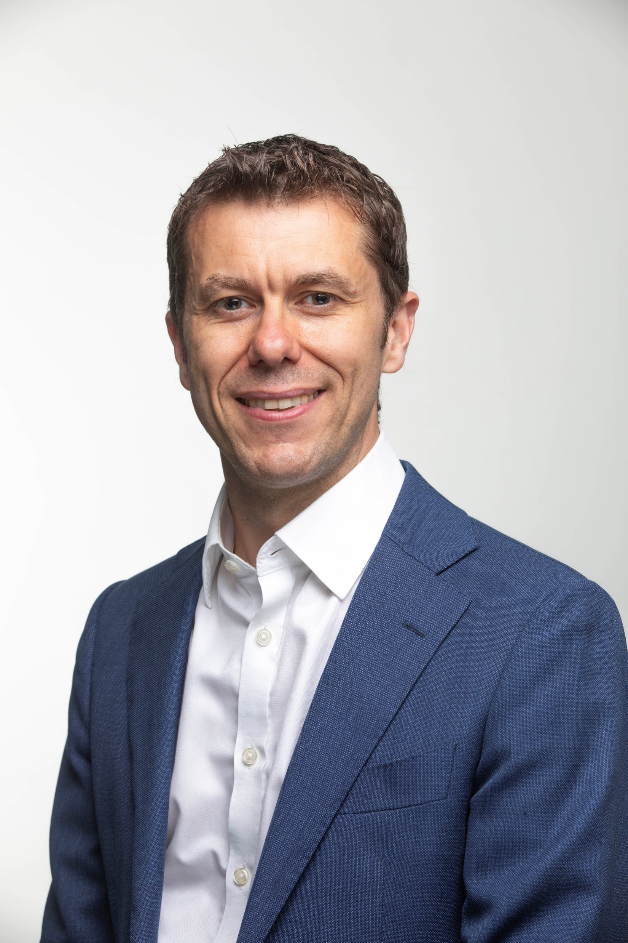
Welcome
Dear Candidate,
This is a role of real significance at an important moment for Ealing. Our Adult Social Care service is strong, stable and trusted, with solid foundations already in place. But we are ambitious for what comes next, and we know the future will demand fresh thinking, visible leadership and a clear focus on how we work differently with residents, partners and communities.
This is not about maintaining the status quo. It is about taking the next step. The service has earned credibility through strong delivery, financial discipline and effective partnership working. The challenge now is to build on Ealing’s strong foundations, bring innovation and strategic clarity, and lead the next phase of transformation to continue improving outcomes and reducing inequalities across the system to help residents stay independent, safe and well for longer in a way that is both ambitious and sustainable.
The next Strategic Director will inherit committed political leadership, strong professional relationships and teams with real expertise and dedication. We are looking for someone who can lead confidently in that context, shaping the next phase of Adult Social Care and Public Health with strategic vision, strong corporate leadership and the ability to influence across complex systems.
For the right candidate, this is a rare opportunity to shape services that matter deeply to residents and communities. You will be joining an organisation that is ambitious for its borough, confident in its direction and ready to think differently about prevention, integration and long-term impact. If you are excited by the opportunity to help shape the next phase of Adults and Public Health in Ealing, this is a role with genuine scope to deliver meaningful change.
Best wishes,
Tony Clements
Chief Executive, Ealing Council
Tony Clements
Chief Executive, Ealing Council

Slide 3
About London Borough of Ealing
Read our progress with unity report here.
Read our review of Ealing’s adult social care here.
Read our Market Position Statement on adult social care here.
Read our transformation and care quality commission assurance brief here.
Read our agenda for our HASSP (Health and Adult Services Scrutiny Panel) here.

Slide 4


The Opportunity
Strategic Director – Adults and Public Health
Salary circa £180k
Closing date: Friday 3 July, 10am
We are looking for an ambitious, visible and collaborative leader who can help shape the future of adult social care in one of London’s most diverse and dynamic boroughs. This is not about maintaining the status quo or driving another round of optimisation, it is about developing a service in the context of a radically changing relationship with our residents.
You will inherit solid foundations and a service that has embraced innovation. The service performs exceptionally in some areas and well in many others. Your challenge will be to take the next step, bring fresh thinking and to lead transformation at a corporate level. You will act as a strong corporate leader across the organisation, and help us to think diﬀerently about prevention, integration and long-term sustainability.
We are looking for someone who can challenge constructively and build conﬁdence with members, colleagues, health partners and communities.
We are particularly interested in leaders who can demonstrate clear examples of innovation and change that align with large scale transformation programmes. You will bring strong ﬁnancial grip and strategic credibility, but also the ability to inﬂuence complex and evolving systems.
You do not need to come from a traditional social work background to apply. What matters most is your leadership and your track record of delivering meaningful change.
At Ealing, we are ambitious for our borough, our organisation and our communities. In a stable political environment, we are building a radically
diﬀerent relationship with our communities.
If you are excited by the opportunity to help shape the next phase of Adult Social Care, we would love to hear from you. At Ealing, we have built a strong and stable Adult Social Care service. It is ﬁnancially disciplined, trusted by partners and delivers good outcomes for residents. The next chapter requires something diﬀerent.
For further information please contact our recruitment partners at Penna:
Continued overleaf…
Kelly Ridley
on 07709 512415 or email: kelly.ridley@penna.com
Dawar Hashmi
on 07513 706265 or email: dawar.hashmi@penna.com

Slide 5
Job Description
Job Title: | Strategic Director Adults & Public Health
Grade: | Strategic Director
Location: | Perceval House
Role reports to: | Chief Executive
Direct reports: | 4
Indirect reports: | 24
Headcount: | Circ 800
Budget: | Accountable for services revenue gross budget of c£103m
• Contribute to the collective corporate leadership of the Council;
• Be a powerful and persuasive advocate of the Council’s vision, values and priorities; and have significant influence across the Council and its partners;
• Champion the Council’s ambition for the people of Ealing and be the Council’s strategic lead for Social Care Integration, Public Health, our Well Being Strategy, Safeguarding and Homelessness, Joint Strategic Needs Assessment and national/regional/local initiatives in relation to Adult’ Social Care and Public Health;
• Provide proactive leadership and professional guidance to the Chief Executive, the Leader, Strategic Leadership Team and the Council on all matters related to Adults and Public Health; and discharge all relevant statutory responsibilities relating to their services including the statutory duties of the Director of Adults’ Services.
Key accountabilities
Strategic and corporate responsibility
• To be the corporate lead for the Council on all aspects of effective safeguarding and the health and wellbeing for the borough.
• To act as the ‘Accountable Person’ under the Building Safety Act 2022 for relevant activities /properties within your portfolio.
• Working with partners, lead and promote continuous improvement through the development and implementation of strategies and mechanisms in adults’ social care and Public Health to secure effective outcomes for adults locally and sub-regionally.
• To develop proactively appropriate external partnership working to devise new strategic innovative approaches to service delivery that help to deliver the medium-term financial strategy and longer term strategic objectives.
•To provide strategic leadership working internally and externally across functional and organisational boundaries to integrate and deliver high quality and effective Adult Services.
• To be the Council’s strategic lead for a range of statutory safeguarding services to adults.
• To establish, develop and maintain effective partnerships with all stakeholders involved in the delivery of services to adults across Ealing including the provision of support to the Ealing Safeguarding Adults Board.
This role profile is non-contractual and provided for guidance. It will be updated and amended from time to time in accordance with the changing needs of the council and the requirements of the job.
Purpose of role
The overarching purpose of the role is to deliver the policy aspirations and commitments of the Council, working with the Chief Executive and Strategic Leadership Team (SLT) colleagues to:-
• Provide strategic leadership and work internally and externally across functional and organisational boundaries to deliver services to Adults in the Borough and in relation to Public Health;

Slide 6
Job Description
• To develop and embed within the service a customer focused culture that fully supports and is aligned with an integrated and accessible service for Adult Service customers in Ealing.
• To be responsible for effective budget and resource management, encompassing the optimisation of value for money, robust and transparent monitoring, forecasting, corrective action and reporting.
• To be accountable for services revenue gross budget £103m
Managing self
• To manage personal workload, changing priorities and personal objectives.
• To maintain relevant and proportionate understanding of the trends and issues relating to areas of specific responsibility and local government and public services as whole.
Leading and managing people
• To create and maintain a positive organisational culture that promotes the council’s values and inspires guides and develops staff.
• To represent the Chief Executive and the Council at meetings/boards/forums with external partners/organisations as appropriate.
• To make a major and visible contribution to the corporate leadership of the council as a member of corporate board, advocating and modelling the council’s vision, values, behaviours and priorities.
• To be the strategic lead in meeting the requirements of the medium-term financial strategy in allocated services.
• To lead the establishment and development of internal/external partnerships to facilitate the co-ordination and delivery of the council’s objectives in adults’ social care and public health; and
• To be the strategic lead in ensuring effective consultation/communication mechanisms with all appropriate stakeholders, including service users are implemented for allocated services.
Service and resource management
• To be accountable for ensuring the effective organisation and management of allocated services to meet relevant statutory requirements, service delivery and corporate plan objectives.
• To maintain a clear vision that places safeguarding and improving outcomes for vulnerable adults at the centre of the Directorate approach, ensuring that the Authority meets regulatory and other legal and policy standards.
• To lead and join up business plans and strategies for all areas of responsibility across the department, ensuring effective consultation with customers, partners and other departments including Health partners,
police and Community groups.
• To discharge statutory duties across the department and partnerships and advise Members and the corporate management team in relation to policies, priorities and strategies related to these matters.
• To establish and achieve a performance-driven culture, in line with the corporate vision and values, ensuring effective preparation for external inspection is in place and where required develop post inspection improvement plans.
• To work with the ICB and provider organisations to commission and ensure the delivery of integrated health & social care services for adult customers in accordance with the Council’s strategies and action plans.

Slide 7
Job Description
• Ealing Safeguarding Adult Board, Partnership Boards; West London Alliance; WLMHT, LNWHT & other Service provider organisations
• Peers across the Council; Local strategic partners; and
• External organisations and funding bodies such as London Councils, other local authorities
• Government and the GLA
Authority level (people, policy, financial):
• For all aspects of people management including effective recruitment, induction, employee relations, performance management, disciplinary and grievance matters
• For policy development and implementation subject to Chief Executive, Corporate Board and Member approval as appropriate
• For providing professional advice to Chief Executive, corporate board and cabinet with relevant legal, financial and other key implications
• For delivery of goals, objectives and targets with the Council’s Corporate Plan, JSNA, Health and Well Being Strategy
• For annual revenue gross budget of c£103m
• To develop effective working relationships with councillors.
• To lead two way and proactive communication to, from and within services including team briefings, meetings, staff development days etc., using a variety of media and approaches.
• To provide direction and leadership to staff within the allocated services and outside of it, including for direct reports, all aspects of staff management (recruitment, induction, production of personal objectives, monitoring of staff performance data, performance management etc), performance conversations and management of poor performance).
• To develop and promote a performance culture.
• To lead and support the learning and development of staff, including creation of personal development plans and supporting the release of staff for corporate learning and development initiatives.
• To ensure that all management processes comply with the Council’s procedures including but not limited to Health & Safety, the Diversity and Equality Strategy and practice, financial regulations and Codes of Conduct.
Key performance indicators
Organisational effectiveness as measured through:-
• Progress in delivering the objectives of the Council.
• Progress in meeting statutory/key indicators in allocated services; Progress in delivering the objectives of the Community Strategy; Delivery of Corporate Plan commitments.
• Customer and resident satisfaction (measured by the Residents Survey); Employee satisfaction (measured through the staff survey); Improvement in key corporate performance indicators.
• Progress in addressing inequality and reducing homelessness in the borough; and Effective budget management.
Key relationships (internal and external)
• Chief Executive, Strategic Leadership Team, DCS, Leader, Cabinet, Elected Members; Local/Sub-regional health trusts.
• Health & Well Being Board

Slide 8
Person Specification
Community and partnership working are essential for all roles as are a commitment to Equality, Diversity and Inclusion and ensuring Health and Safety at Work for everyone working at Ealing Council.
Recruitment practices to safeguard and promote the welfare of children and/or vulnerable adults apply to this post in addition to the requirement to obtain a Disclosure and Barring Service (DBS) check.
Essential knowledge, skills and abilities | Essential experience
Ability to initiate, develop and implement effective strategies to address complex crosscutting issues in Adults Social Care and Public Health. | A track record of sustained improvement in Adults Social Care at a senior level in an organisation of comparable scope and complexity.
Proven ability to work across functional, professional and organisational boundaries including the management and leadership of multi-disciplinary teams. | Experience of integration with Health and partnership working with a wide range of stakeholders and multi-agency services at all levels including very senior managers and customers across Health, Police and community sectors.
A solid understanding of the principles and practice of corporate management, strategic planning and business performance improvement. | Experience of working in a political environment, of developing effective and productive working relationships coupled with sound political acumen.
Credible and visible leadership skills capable of establishing high levels of trust, shared purpose and motivation among a wide range of internal and external constituencies. | Significant experience in leading successful programmes of substantial beneficial change; Experience of managing team(s) at a senior level, appropriate to the role.
Ability to influence and persuade, to foster collaboration and achieve results through others; Comprehensive knowledge of the adults’ social care sectors both in operation/function and associated strategic issues/challenges nationally/regionally and locally. | A track record of delivering significant service improvements within a large organisation with clear outcomes for adults.
Highly developed analytical skills. | Proven experience of leading and managing staff including recruitment induction, objective setting, coaching, performance reviews and timely intervention of poor performance; Experience of resource management and business analysis skills, including budget management.
Continued overleaf...

Slide 9
Person Specification
Essential knowledge, skills and abilities | Essential experience
Ability to exercise and apply critical judgement to complex and sensitive issue. | A proven track record of success in championing equality, diversity and inclusion and furthering equalities objectives.
Excellent communication skills, with the proven ability to present to a diverse range of internal and external audiences using a variety of media and approaches.
Experience and knowledge of resource management techniques and the ability to co-ordinate effective and robust budgetary management including forecasting, corrective action, delivering efficiencies, assessment of value for money, and the production of business cases.
Personal integrity, determination, energy and resilience.
Ability to create, contribute to and maintain a highly supportive and motivational corporate organisational culture of high performance and customer service excellence.
Essential qualification(s) | Desirable qualifications
Educated to Degree Level or equivalent | Leadership/Management Qualification e.g. ILM level 7 in Strategic Leadership
PQSW, equivalent professional qualification, or equivalent experience | Membership of Appropriate Professional Body
Evidence of continual professional development

Slide 10
Values and Behaviours
Improved life for residents | Trustworthy | Collaborative | Innovative | Accountable
Is passionate about making Ealing a better place | Does what they say they will do on time | Ambitious and confident in leading partnerships | Tries out ways to do things better, faster and for less cost | Encourages all stakeholders to participate in decision making
Can see and appreciate things from a resident point of view | Is open and honest | Offers to share knowledge and ideas | Brings in ideas from outside to improve performance | Makes things happen
Understands what people want and need | Treats all people fairly | Challenges constructively and respectfully listens to feedback | Takes calculated risks to improve outcomes | Acts on feedback to improve performance
Encourages change to tackle underlying causes or issues |  | Overcomes barriers to develop our outcomes for residents | Learns from mistakes and failures | Works to high standards

Slide 11
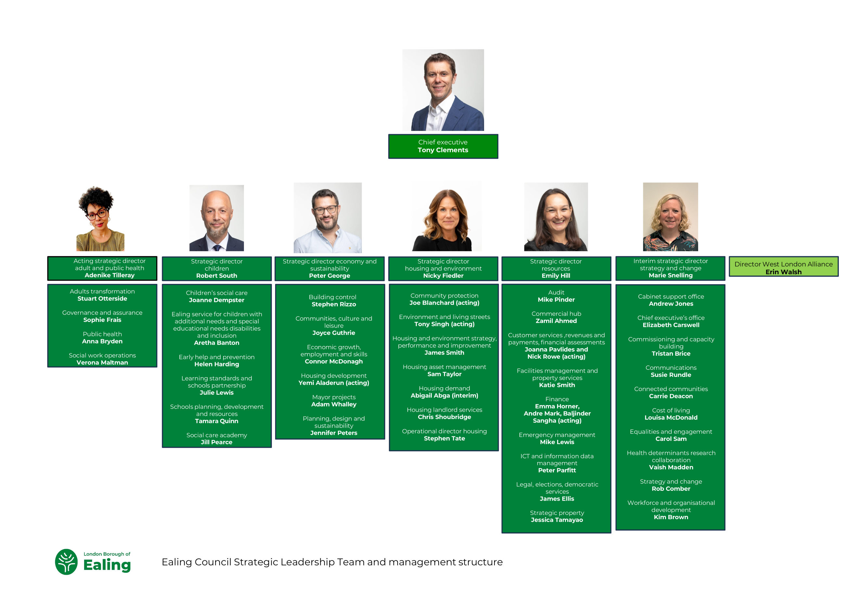

Slide 12
How to Apply
Please apply by submitting a CV and Cover Letter (no more than two sides of A4 in length per document aligned to the person specification). Please also include your contact details.
Please ensure your full employment history is outlined in your CV; where there are essential criteria, competencies and/or qualifications please make clear how you meet these. We may wish to verify this information during the recruitment process.
Please provide the details of two referees. Note that we will only approach referees for candidates proceeding to final selection and only with your permission. Please clearly indicate whether we can approach each referee before the selection date.
Please share with us in your Supporting Statement the values and behaviours that you bring to your leadership, and how you will transfer your skills and experience into this role.
Please complete the Equal Opportunities Monitoring Form when you upload your details via the Penna website.
Please upload your application by the closing date – no applications will be accepted once the role has closed.
Following long-listing, you will be contacted directly by a Penna consultant to update you on the status of your application.
Asking for adjustments: We’re committed to making our recruitment practices barrier-free and as accessible as possible for everyone. This includes making adjustments or changes for disabled people, neurodiverse people or people with long-term health conditions. If you would like us to consider doing anything differently during the application, interview, or assessment process, including providing information in an alternative format, please contact Penna.
To apply for this role, please visit the following link to upload your CV and Cover Letter: https://penna.com/jobs
Date | Stage
Friday 3 July at 10am | Application Deadline
Monday 6 July | Longlist Meeting (candidates are not required to attend)
Monday 13 and Tuesday 14 July | Technical/Preliminary Interviews
Thursday 16 July | Shortlist Meeting (candidates are not required to attend)
Thursday 16 July – Assessments sent to shortlisted candidates | Psychometric assessments sent to shortlisted candidates
W/C 20 July | Feedback calls with psychometric assessor
Wednesday 22 July | Stakeholder Panel Interviews (In person – address TBC)
Monday 27 July | Final interviews (In person – address TBC)

Slide 13

Penna Executive Search
Inclusive Leadership …Redefined!
At Penna, we specialise in connecting outstanding professionals to senior leadership roles that shape the future of local government.
Our decades of experience working with local authorities set us apart. We understand the demands of political leadership, the importance of corporate plans, and the skills needed to navigate complex, challenging environments.
We work with integrity, imagination, and determination to ensure every placement is the right fit. Whether you are looking for leaders who can deliver major change initiatives, champion high performance cultures, or build stronger partnerships with communities and stakeholders, our specialist team will help you find the talent who can turn vision into reality.
At Penna, we want to build leadership that delivers stronger, fairer, and more sustainable communities.
www.penna.com

